Slide 1

Data Visualization and Reporting Tool
Mojtaba Ghasemi

Slide 2





About me
Mojtaba Ghasemi
Senior Data Scientist
Ph.D. in Biomedical Engineering fromUniversity de Montreal
https://github.com/MJTGhasemi
https://ca.linkedin.com/in/mojtabaghasemi/
420-TT3-UM - Data Visualization and Reporting Tool | Montreal College IT

Slide 3
About you
- Background
- Enrolled program
- Highest education level
- Programming experience
420-TT3-UM - Data Visualization and Reporting Tool | Montreal College IT

Slide 4
Course Outline
- Data Foundation: Statistics
Descriptive Statistics
Introduction to Probability
Inferential Statistics
- Introduction to BI Solutions
Introduction to Business Intelligence
Introduction to Data Scientist
Introduction to Data Visualization
- Introducing Power BI and Power BI Services
Power BI Desktop
Designing Dashboards
Row-Level Security
- Power BI Data and Modeling
Transforming and Merging Data
Calculated Columns and Measures
420-TT3-UM - Data Visualization and Reporting Tool | Montreal College IT

Slide 5
Course Evaluations
- Assignments
25%
- Projects
25%
- Final Exam
50%
420-TT3-UM - Data Visualization and Reporting Tool | Montreal College IT

Slide 6

Data
Data refers to information gathered from different sources (sensor measurements, events, text, images, videos, etc.) through observations, measurements, research or analysis in order to provide:
Informed decision-making
Problem solving
Trend analysis
Performance measurement
Innovation
Personalization (tailor service to individual preferences)
Optimization
Risk management
Etc.
420-TT3-UM - Data Visualization and Reporting Tool | Montreal College IT

Slide 7
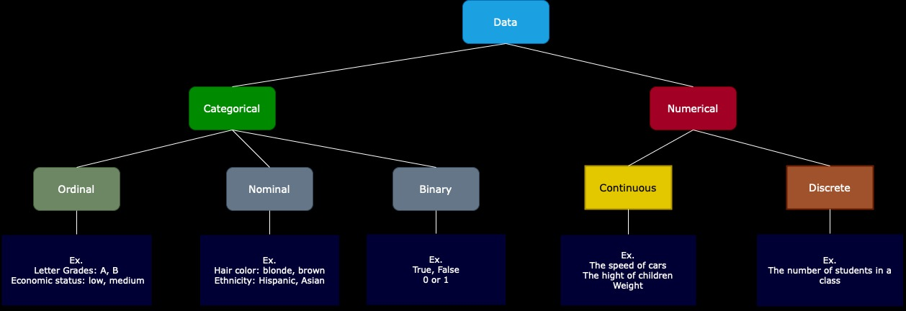
Data Types
Categorical: Data that can take on only a specific set of values representing a set of possible categories. (Synonyms: enums, enumerated, factors, nominal)
Binary: A special case of categorical data with just two categories of values, e.g., 0/1, true/false. (Synonyms: dichotomous, logical, indicator, boolean)
Ordinal: Categorical data that has an explicit ordering. (Synonym: ordered factor)
Nominal: represents discrete units and is used to label variables without providing any quantitative value or rank among categories
Numeric: Data that are expressed on a numeric scale.
Continuous: Data that can take on any value in an interval. (Synonyms: interval, float)
Discrete: Data that can take on only integer values, such as counts. (Synonyms: integer, count)
420-TT3-UM - Data Visualization and Reporting Tool | Montreal College IT

Slide 8
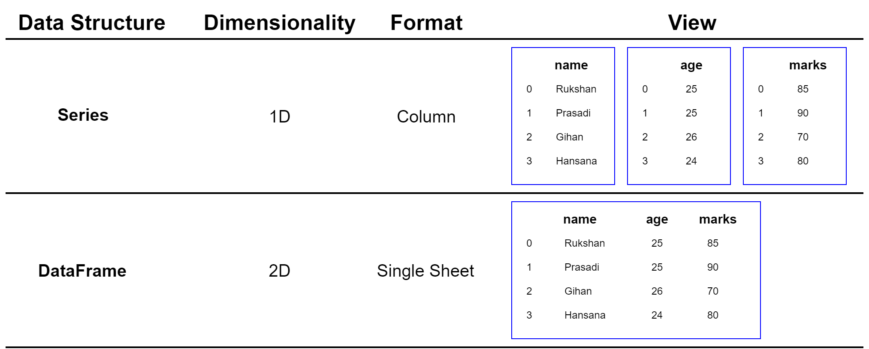
Data Structure
Series:
A Series is a one-dimensional labeled array capable of holding any data type. It is like a column in a table, ideal for representing one-dimensional data structures like a list of values.
DataFrame:
A two-dimensional labeled data structure with columns of potentially different types You can think of it like a spreadsheet or SQL table.
420-TT3-UM - Data Visualization and Reporting Tool | Montreal College IT

Slide 9
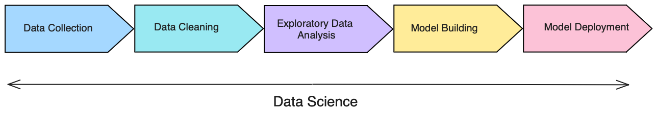
Understanding Data Cycle
- Data Collection: Aggregate and store data
- Data Cleaning: Data is usable and easily accessible
- Exploratory Data Analysis (EDA): Look for trends and high-level insights
- Model Building: Predict outcomes form the analysis
- Model Deployment: Make the model scalable for the business
420-TT3-UM - Data Visualization and Reporting Tool | Montreal College IT

Slide 10
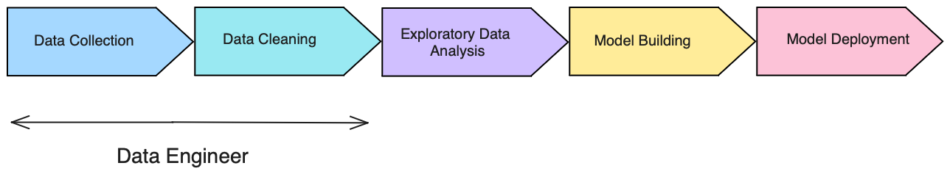
Understanding Data Cycle
Data Engineer:
Focuses on data collection and data cleaning
Strong SQL skills (pulling data and transforming it)
Extract, Transform, Load jobs (ETL)
Database maintenance techniques skills
420-TT3-UM - Data Visualization and Reporting Tool | Montreal College IT

Slide 11
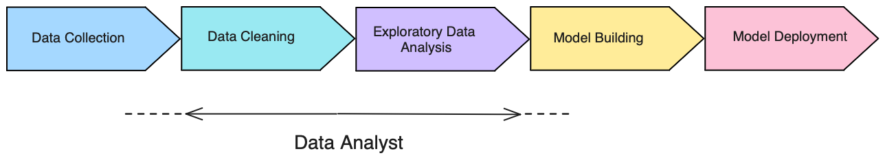
Understanding Data Cycle
Data / BI Analyst:
Focuses on data cleaning and EDA
Strong business intelligence skills (Excel, Power BI, Tableau)
Python, R skills
Do some data collection and model building tasks
420-TT3-UM - Data Visualization and Reporting Tool | Montreal College IT

Slide 12
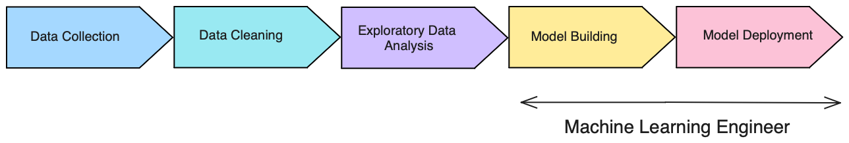
Understanding Data Cycle
Machine Learning Engineer (MLE):
Focuses on model building and putting models into production
Strong Python and other language (java, scala) skills
Strong understanding of ML tools and production environment
Software engineering skills
420-TT3-UM - Data Visualization and Reporting Tool | Montreal College IT

Slide 13
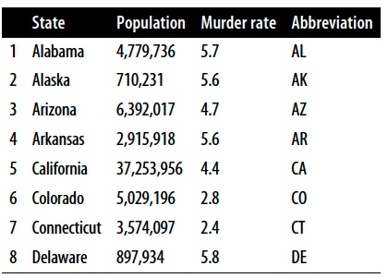
Statistics
What is statistics?
One of the best ways to get information from numerical data. It’s used to estimate or measure a parameter.
Why is statistics vital?
The important role of statistics is to represent unstructured data in the form of tables, graphs, and charts.
420-TT3-UM - Data Visualization and Reporting Tool | Montreal College IT

Slide 14
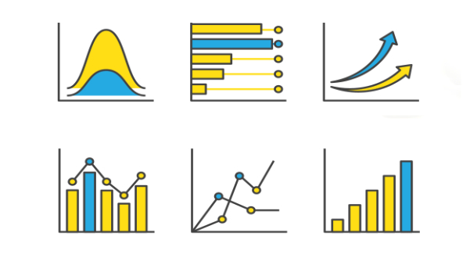
The important role of Statistics in Data Science
Statistics will provide a roadmap for the whole process of data science.
Statistics is one of the major parts of the data science field and helps us get better results from data, validating models and underlying patterns.
Statistics allows data scientists to quantify uncertainty and make predictions while accounting for randomness and variability in data.
Statistics enables decision-makers to derive insights from data through hypothesis testing, probability, and predictive modeling, leading to more informed and evidence-based decisions.
420-TT3-UM - Data Visualization and Reporting Tool | Montreal College IT

Slide 15
Sample, Population, and Descriptive Statistics
420-TT3-UM - Data Visualization and Reporting Tool | Montreal College IT

